Slide 1
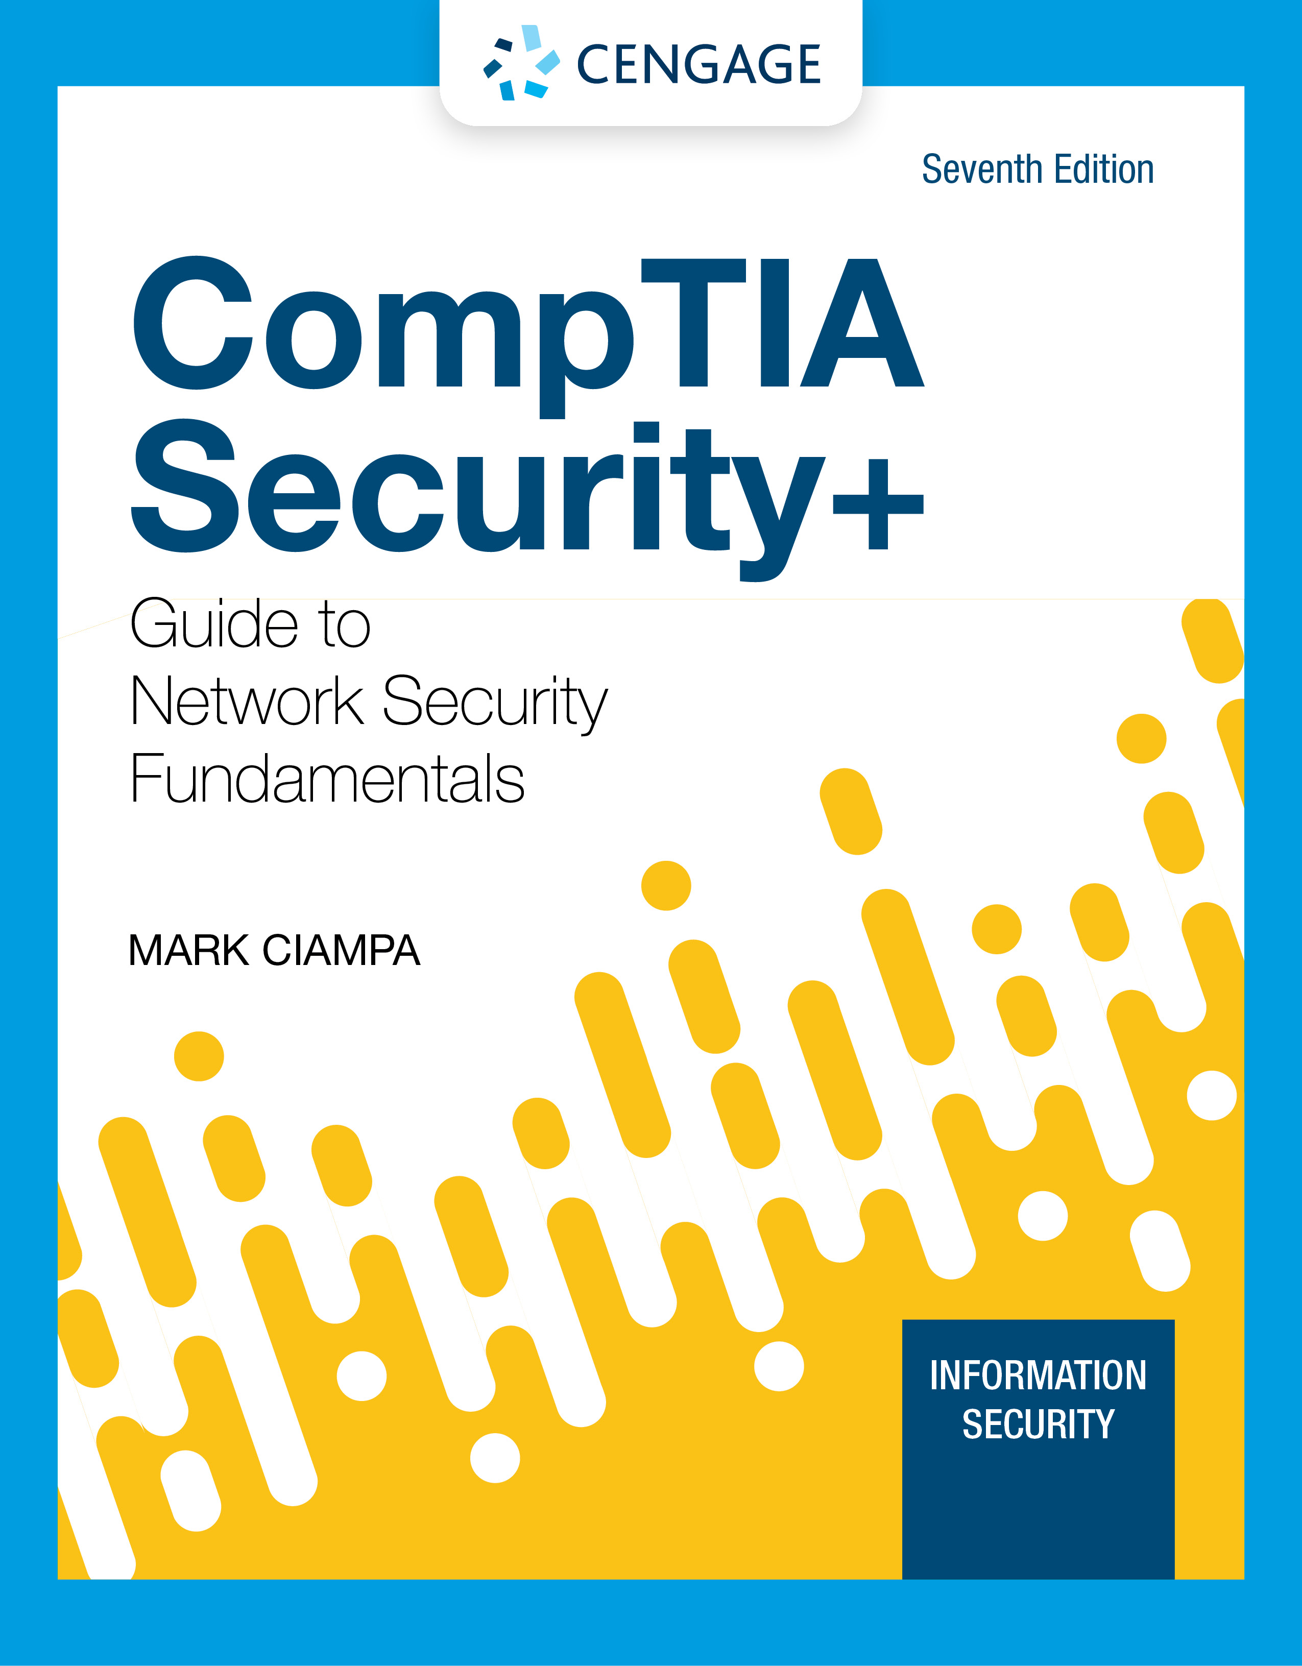
Module 10: Cloud and Virtualization Security
CompTIA Security+ Guide
to Network Security Fundamentals, 7th Edition

Slide 2
Module Objectives
By the end of this module, you should be able to:
1. Define the cloud and explain how it is used and managed
2. Explain virtualization
3. Describe cloud and virtualization security controls
4. List different secure network protocols

Slide 3
Cloud Security
Understanding cloud security involves an overall introduction to cloud computing
It also means understanding the steps to take in order to secure the cloud computing environment

Slide 4
Introduction to Cloud Computing (1 of 6)
In a hosted services environment, servers, storage, and the supporting networking infrastructure are shared by multiple enterprises over a remote network connection
Cloud computing is a model for enabling convenient, on-demand network access to a shared pool of configurable computing resources
Entities that offer cloud computing are called cloud service providers
The savings available through cloud computing are due to the following factors:
Elasticity and scalability
Pay-per-use
On demand
Resiliency

Slide 5
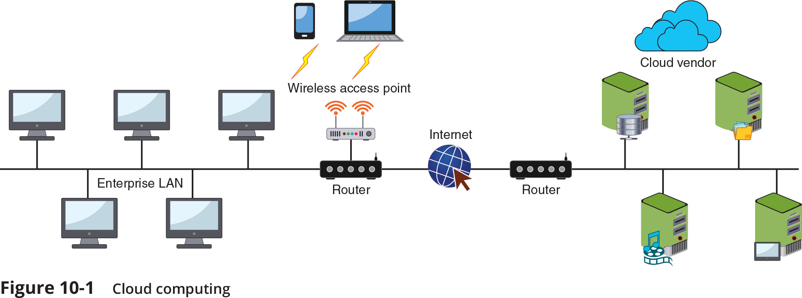
Introduction to Cloud Computing (2 of 6)

Slide 6
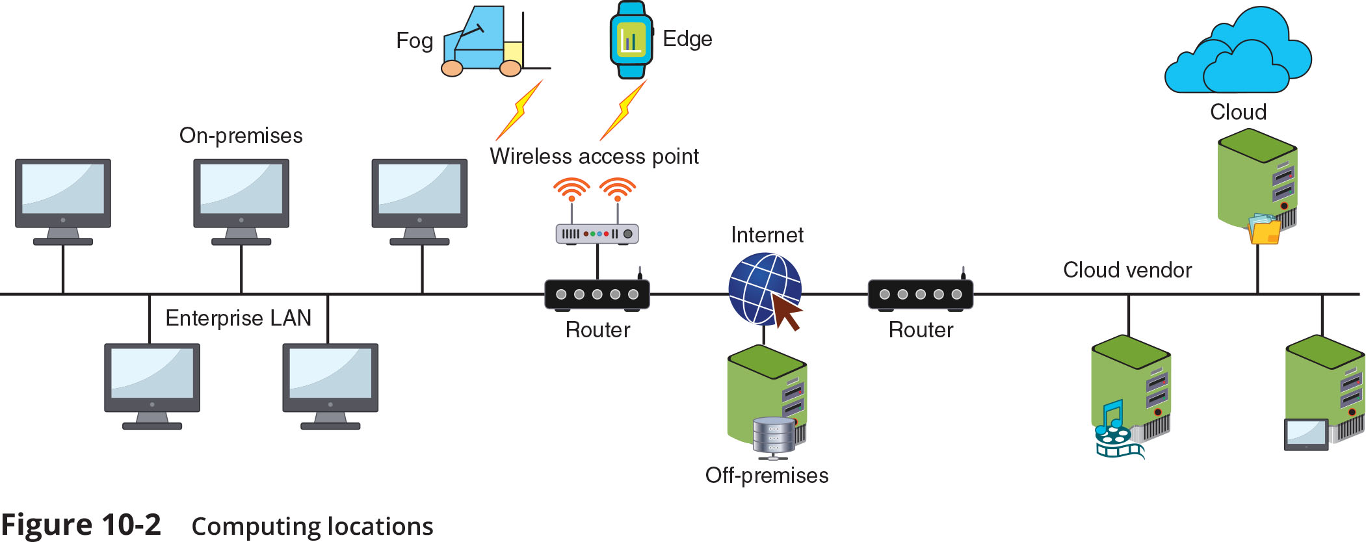
Introduction to Cloud Computing (3 of 6)

Slide 7
Introduction to Cloud Computing (4 of 6)
Cloud Architecture
Thin client is a computer that runs from resources stored on a central cloud server
Transit gateway is an Amazon Web Services (AWS) technology that allows organizations to connect all existing virtual private clouds (VPCs), physical data centers, remote offices, and remote gateways into a single managed source
Serverless infrastructure is one in which the capacity planning, installation, setup, and management are all invisible to the user because they are handled by the cloud provider

Slide 8
Introduction to Cloud Computing (5 of 6)
There are four service models in cloud computing:
Software as a Service (SaaS)
Vendor provides access to the vendor’s software applications running on a cloud infrastructure
Platform as a Service (PaaS)
Consumers install and run their own specialized applications on the cloud computing network
Infrastructure as a Service (IaaS)
Vendor allows customers to deploy and run their own software, including OSs and applications
Anything as a Service (XaaS)
A broad category of subscription services related to cloud computing

Slide 9
Introduction to Cloud Computing (6 of 6)
Management
Cloud management can be conducted by the local organization performing the work itself or by contracting with a third-party management service provider
Services integration attempts to achieve a “boundary-less” approach
Involves integrating all users across the enterprise who are using cloud computing
When locally managing cloud computing, an enterprise should have written resource policies in place
They must outline who is responsible for cloud computing, what are their duties and responsibilities, how cloud computing can be used (and not used), and the processes for acquiring these resources
A managed service provider (MSP) delivers services through ongoing and regular support as well as active administration of those resources
An MSP assumes the role of a traditional on-prem IT organization

Slide 10
Securing Cloud Computing (1 of 6)
Security issue | Description
Unauthorized access to data | Improper cloud security configurations can result in data being left exposed.
Lack of visibility | Organizations have limited or no visibility into the security mechanisms of the cloud provider and thus cannot verify the effectiveness of security controls.
Insecure application program interfaces (APIs) | While APIs help cloud customers customize their PaaS by providing data recognition, access, and effective encryption, a vulnerable API can be exploited by threat actors.
Compliance regulations | Maintaining compliance requires that an organization know where its data is, who can access it, and how it is protected, but this can be difficult in an opaque cloud system, which lacks transparency.
System vulnerabilities | A cloud infrastructure is prone to system vulnerabilities due to complex networks and multiple third-party platforms.

Slide 11
Securing Cloud Computing (2 of 6)
Cloud Security Controls
Securing cloud computing involves using controls such as the following:
Conducting audits – a cloud security audit is an independent examination of cloud service controls
Use Regions and Zones – reliability and resiliency are achieved through duplicating processes across one or more geographical areas (called high availability across zones)
Secrets management – enables strong security and improved management of a microservices-based architecture, allowing the entire cloud infrastructure to remain flexible and scalable without sacrificing security
Enforce Functional Area Mitigations – See Table 10-6

Slide 12
Securing Cloud Computing (3 of 6)
Feature | Description
Limited and automated replication | While secret data and secret names are “project-global” resources, the secret data is stored in regions, which the user can specify or the cloud provider can designate.
Secret-specific versioning | A secret can be pinned to a specific version of the code (like “v3.2”).
Audit logging | Every interaction generates an audit entry in a log file that can be used to find abnormal access patterns that may indicate possible security breaches.
Default encryption | Data is encrypted in transit and at rest with AES-256-bit encryption keys.
Extensibility | One system is able to extend and integrate into other existing secrets management systems.

Slide 13
Securing Cloud Computing (4 of 6)
Application Security
One of an organization’s security protections for cloud computing application security is to use a cloud access security broker (CSAB)
CASB is a set of software tools or services that resides between the enterprises’ on-premises infrastructure and the cloud provider’s infrastructure
CASB acts as a “gatekeeper”, ensuring that the security policies of the enterprise extend to its data in the cloud
Security Virtual Device Solutions
A next generation secure web gateway (SWG) examines both incoming and outgoing traffic and performs basic URL and monitoring in web applications
A cloud firewall is virtual software that functions in a similar manner to a physical security appliance by examining traffic into and out of the cloud

Slide 14
Securing Cloud Computing (5 of 6)
Lack of a Cloud Conceptual Model
Physical networks use the Open Source Interconnection (OSI) seven-layer model to illustrate network functionality
With cloud computing, the OSI model is no longer as useful
The lack of a conceptual model like the OSI model makes selecting and managing security virtual devices more challenging
Different cloud-based conceptual models are starting to be proposed
However, no single model has been widely adapted
One model is shown in Table 10-7

Slide 15
Securing Cloud Computing (6 of 6)
Layer and name | Description | Party responsible
5—Application Experience | End-user facing interface | Customer
4—Native Service | Create, store, process | Customer
3—Software-Defined Datacenter | Create infrastructure | SaaS—Cloud computing provider PaaS and IaaS—Customer
2—Virtualization Software | Software that virtualizes the hardware | Cloud computing provider
1—Physical Infrastructure | Buildings, power, cables, hardware, utilities | Cloud computing provider

Slide 16
Knowledge Check Activity 1
Which cloud security control provides reliability and resiliency through the duplication of processes across geographical areas?
a. Conducting audits
b. Implementing secrets management
c. Using regions and zones
d. Enforcing functional area mitigations

Slide 17
Knowledge Check Activity 1: Answer
Which cloud security control provides reliability and resiliency through the duplication of processes across geographical areas?
Answer: c. Using regions and zones
In a cloud computing environment, reliability and resiliency are achieved through duplicating processes across one or more geographical areas. This is called using regions and zones or high availability across zones.

Slide 18
Virtualization Security
Virtualization security involves an understanding of the topic along with specific examples
It includes specific steps to be taken to secure a virtualized environment

Slide 19
Defining Virtualization (1 of 5)
What is Virtualization?
Virtualization is a means of managing and presenting computer resources without regard to physical layout or location
Host virtualization is a type of virtualization in which an entire operating system environment is simulated
A virtual machine (VM) is a simulated software-based emulation of a computer
The host system runs a hypervisor that manages the virtual operating systems and supports one or more guest systems
Virtualization is used to consolidate multiple physical servers into VMs that can run on a single physical computer

Slide 20
Defining Virtualization (2 of 5)
The VM monitor program is called a hypervisor, which manages the VM operating systems
Two types of hypervisor:
Type I – run directly on the computer’s hardware instead of the underlying OS
Type II – run on the host OS, much like an application
A container holds only the necessary OS components that are needed for that specific application to run
Reduces the necessary hard drive storage space and RAM needed
Allows for containers to start more quickly because the OS does not have to be started

Slide 21
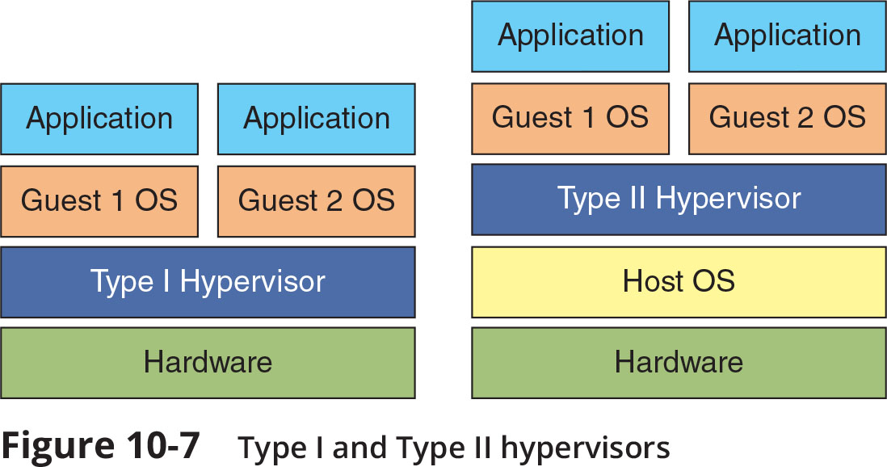
Defining Virtualization (3 of 5)

Slide 22
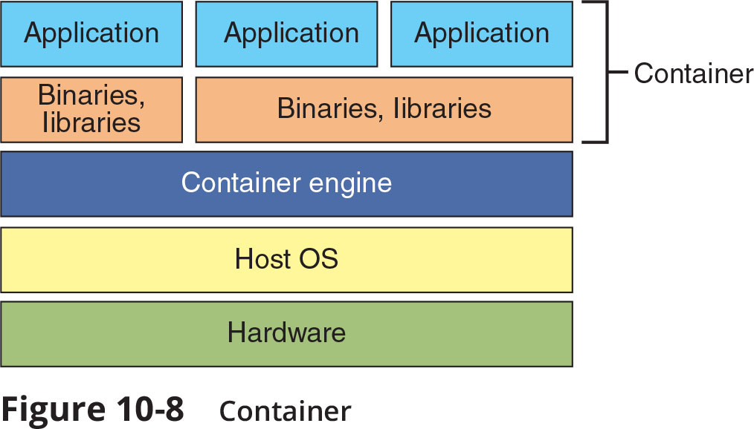
Defining Virtualization (4 of 5)

Slide 23
Defining Virtualization (5 of 5)
Advantages of Virtualization
New virtual server machines can be made available (host availability) and resources can easily be expanded or contracted as needed (host elasticity)
Can reduce costs
Fewer physical computers must be purchased and maintained
Can provide uninterrupted server access to users
Supports live migration which allows a virtual machine to be moved to a different physical computer with no impact to users

Slide 24
Infrastructure as Code (1 of 2)
Software defined network (SDN)
An SDN virtualizes parts of the physical network so that it can be more quickly and easily reconfigured
This is accomplished by separating the control plane from the data plane
If traffic needs to flow through the network:
It receives permission from the SDN controller, which verifies the communication is permitted by the network policy of the enterprise
Once approved, the SDN controller computes a route for the flow to take and adds an entry for that flow in each of the switches along the path

Slide 25
Infrastructure as Code (2 of 2)
Software-Defined Visibility (SDV)
Software-defined visibility (SDV) is a framework that allows users to create programs in which critical security functions can be automated
SDV allows network administrators to automate multiple functions in a network infrastructure including:
Dynamic response to detected threat patterns
Adjustments to traffic mode configurations for in-line security tools
Additional IT operations-management functions and capabilities

Slide 26
Security Concerns for Virtual Environments (1 of 3)
Security-related advantages of virtualization:
Test latest security updates by downloading on a virtual machine before installing on production computers
A snapshot of a particular state of a virtual machine can be saved for later use
Testing the existing security configuration (security control testing) can be performed using a simulated network environment
VMs can promote security segregation and isolation
A suspicious program can be loaded into an isolated virtual machine and executed (sandboxing)
If the program is malware, only the virtual machine will be impacted

Slide 27
Security Concerns for Virtual Environments (2 of 3)
Security concerns for virtualized environments:
Not all hypervisors have the necessary security controls to keep out attackers
Existing security tools were designed for single physical servers
VMs must be protected from both outside networks and other VMs on the same physical computer
VMs may be able to “escape” from the contained environment and directly interact with the host OS
Important to have virtual machine escape protection
Virtual machine sprawl is the widespread proliferation of VMs without proper oversight or management
Combating VM sprawl is called virtual machine sprawl avoidance
Installing a virtual machine manager can help

Slide 28
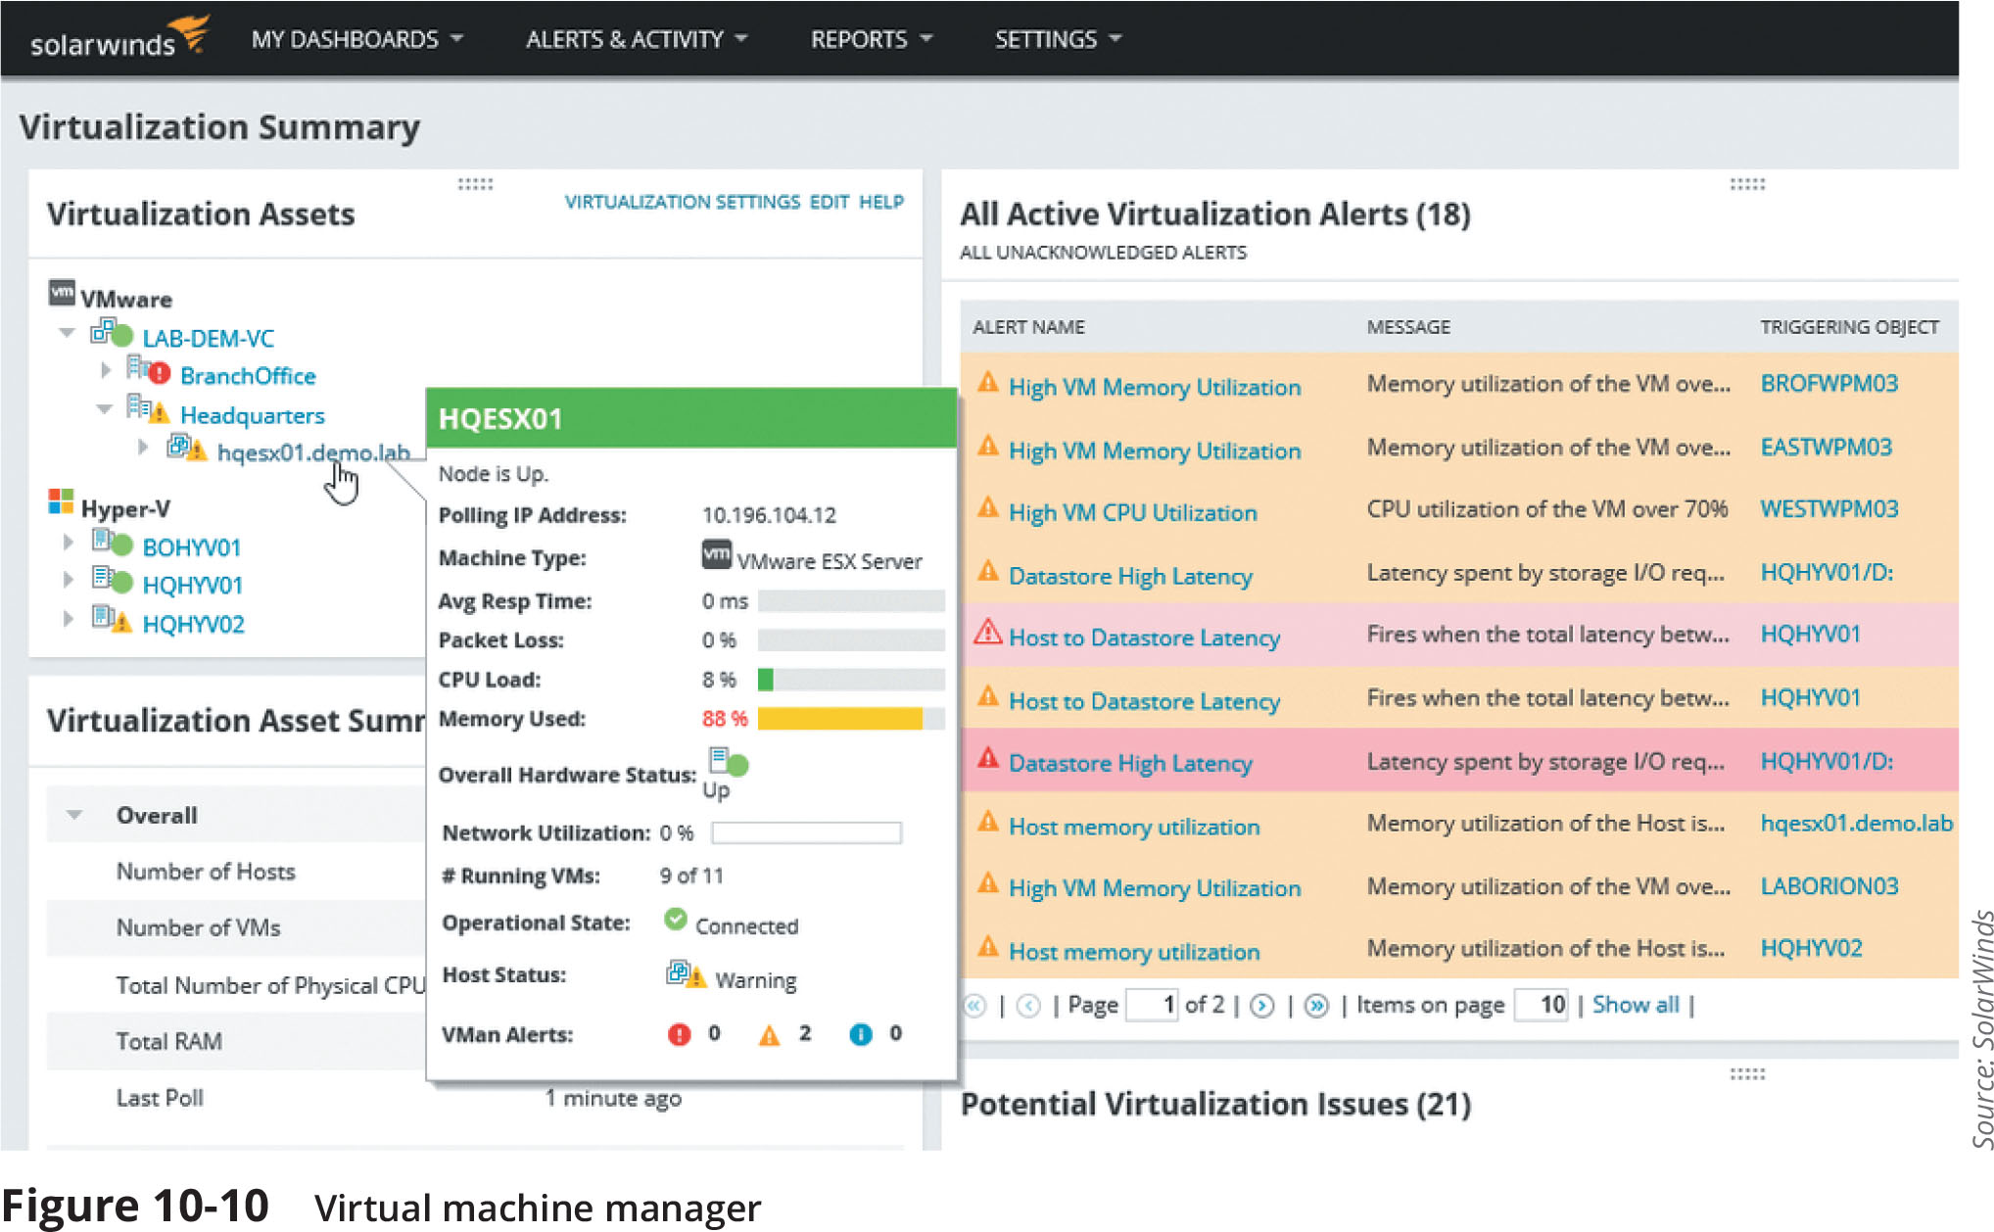
Security Concerns for Virtual Environments (3 of 3)

Slide 29
Knowledge Check Activity 2
What virtualization technology separates the control plane from the data plane on networking devices such as switches and routers?
a. SDV
b. Hypervisor
c. Containers
d. SDN

Slide 30
Knowledge Check Activity 2: Answer
What virtualization technology separates the control plane from the data plane on networking devices such as switches and routers?
Answer: d. SDN
A software-defined network (SDN) virtualizes parts of the physical network by separating the control plane from the data plane.

Slide 31
Secure Network Protocols
Common secure network protocols include:
Simple Network Management Protocol (SNMP)
Domain Name System (DNS) Security Extensions
File Transfer Protocol
Secure email protocols
Lightweight Directory Access Protocol (LDAP)
Internet Protocol version 6 (IPv6)

Slide 32
Simple Network Management Protocol (SNMP)
SNMP is used to manage network equipment and is supported by most network equipment manufacturers
It allows administrators to remotely monitor, manage, and configure network devices
SNMP functions by exchanging management information between network devices
Each SNMP-managed device has an agent or a service
Listens for and executes commands
Agents are password protected
Password is known as a community string
Security vulnerabilities were present in SMNP versions 1 and 2
Version 3 uses usernames and passwords along with encryption to address vulnerabilities

Slide 33
Domain Name System Security Extensions (DNSSEC)
DNS is often the focus of attacks
DNS poisoning and DNS hijacking are examples
These attacks can be thwarted by using Domain Name System Security Extensions (DNSSEC)
DNSSEC adds additional resource records and message header information which can be used to verify the requested data has not been altered in transmission
Using asymmetric cryptography, a private key that is specific to a zone is used in encrypting a hash of a set of resource records
Which is then used to create the digital signature to be stored in the resource record

Slide 34
File Transfer Protocol (1 of 2)
File transfer protocol (FTP) is an unsecure protocol used to connect to an FTP server in order to transfer files
Methods for using FTP on local host computer
Using an FTP client
From a command prompt
Using a web browser
FTP vulnerabilities include:
FTP does not use encryption
Files transferred using FTP are vulnerable to man-in-the-middle attacks

Slide 35
File Transfer Protocol (2 of 2)
There are two options for secure transmissions over FTP
FTP Secure (FTPS) uses SSL or TLS to encrypt commands sent over the control port (port 21)
The data port (port 20) may not be encrypted
Secure FTP (SFTP)
Uses only a single TCP port instead of two ports
All data and commands are encrypted

Slide 36
Secure Email Protocols
Earlier email systems use two TCP/IP protocols to send and receive messages:
Simple Mail Transfer Protocol (SMTP) and Post Office Protocol (POP)
IMAP (Internet Mail Access Protocol) is a more recent and advanced email system
As a means of security, a mail gateway monitors emails for unwanted content and prevents these messages from being delivered
A mail gateway can automatically and transparently encrypt outbound email messages

Slide 37
Lightweight Directory Access Protocol (LDAP)
A directory service is a database stored on the network that contains information about users and network devices
The directory service also keeps track of all the resources on the network and a user’s privileges to those resources and grants or denies access based on the directory service information
Lightweight Directory Access Protocol (LDAP) makes it possible for almost any application running on any computer platform to obtain directory information
A weakness of LDAP is that it can be subject to LDAP injection attacks
This may allow an attacker to construct LDAP statements based on user input statements
The defense against LDAP injection attacks is to examine all user input before processing

Slide 38
Internet Protocol Version 6 (IPv6)
IPv6 addresses weaknesses of IPv4 and also provides other significant improvements
IPv6 increases the number of available addresses
IPv6 has enhanced security features:
IPv6 can implement end-to-end encryption
This makes man-in-the-middle attacks significantly more difficult
IPv6 supports more secure name resolution
The Secure Neighbor Discovery (SEND) protocol can send cryptographic confirmation that an endpoint is who it claims to be
This makes ARP poisoning more difficult

Slide 39
Knowledge Check Activity 3
Which type of networking service is potentially susceptible to LDAP injection attacks?
a. Directory service
b. Domain name service
c. Web service
d. Mail service

Slide 40
Knowledge Check Activity 3: Answer
Which type of networking service is potentially susceptible to LDAP injection attacks?
Answer: a. Directory service
Lightweight Directory Access Protocol (LDAP) is a protocol for using and maintaining directory services which is a database stored on a network that contains information about users and other network services.

Slide 41
Self-Assessment
Rate your competence of the following module objectives on a scale of 1 to 5 where 5 indicates you have full confidence in your competence of that objective and 1 indicates you have very little to no confidence in your competence of that objective. After you self-score, consider why some topics were easier for you to digest than others and review any objective you are not confident about.
1. Define the cloud and explain how it is used and managed
2. Explain virtualization
3. Describe cloud and virtualization security controls
4. List different secure network protocols

Slide 42
Summary (1 of 2)
Cloud computing is a popular and flexible approach to computing resources
A public cloud is one in which the services and infrastructure are offered to all users with access provided remotely through the Internet
On-premises is computing resources located on the campus of the organization while off-premises is a computing resource hosted and supported by a third party
There are many elements that make up a cloud architecture: a thin client, a transit gateway, and a serverless infrastructure
Cloud computing service models include: Software as a Service (SaaS), Platform as a Service (PaaS), Infrastructure as a Service (IaaS), and Anything as a Service (XaaS)
Cloud computing has several potential security issues

Slide 43
Summary (2 of 2)
While securing the functional areas of the cloud is important, an area often overlooked is application security or protecting applications
Virtualization is a means of managing and presenting computer resources by function without regard to their physical layout or location
Instances of virtualization are sometimes referred to as infrastructure as code
There are several secure network protocols that are used today: SNMP, DNSSEC, FTPS, and SFTP
Electronic email systems that are in use today: SMTP/POP3 and IMAP

